Slide 1
Sprint 2 Demo
1095-B TAX DOCUMENT
Tuesday, February 22nd, 2022

Slide 2














Get to know the team
Core team
Executive team
PRODUCT
ENGINEERING
Ashley Castillo Washington DC Product Manager Lead
Jordan White Dallas, TX Product Manager
Tami Corson
North Carolina
Scrum Master
Nadya Primak Washington DC Engineer
Teagan Stephenson Ft. Lauderdale, FL Backend Engineer
Jeff Scheire
MO Studio
Marcy Jacobs
McKinsey
Kevin London Frog
DESIGN
Kit Casey Boston, MA Design Director
Carl Dickerson Atlanta, GA Content Strategist and Plain Language Content Creator
Grace Hong New Jersey Experience Designer
James Lewis Austin, TX Accessibility and UX Research Lead
Will Reynolds SERVE
Ben Morris
Pluribus
02-22 Sprint 2 Demo
Introduction

Slide 3



At the end of each sprint on Tuesdays, the team will run sprint reviews to showcase the sprint’s work for approval. The purpose of this meeting is:
WELCOME TO THE SPRINT 2 DEMO
1
To demo the accomplishments or functionality that was built over the past sprint
2
To get feedback and insights early and often
3
To create transparency for anyone interested on the product and progress
02-22 Sprint 2 Demo
Introduction

Slide 4
Roadmap overview
We are here
PHASE
CY 2021
CY 2022
SPRINT
0
1
2
3
4
5
6
7
8
9
10
11
12
13
14
15
16
17
18
19
20
21
22
23
24
25
MONTH
Sep
Oct
Nov
Dec
Jan
Feb
Mar
Apr
May
Jun
Jul
Aug
FOCUS
DHM - Health Apartment
1095-B Form
TBD
02-22 Sprint 2 Demo
Introduction

Slide 5
1095-B Overview
SPRINT 2 DEMO

Slide 6
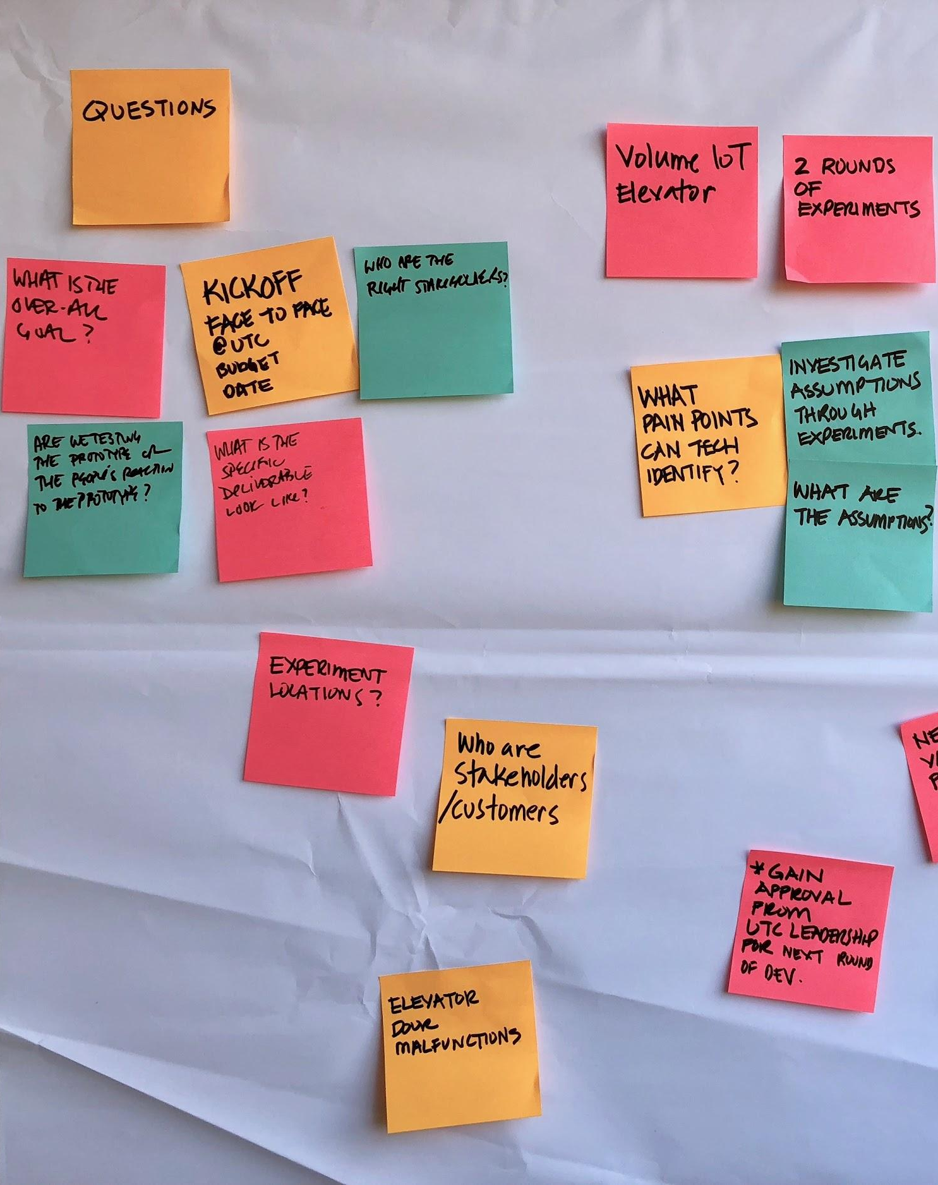
Project objectives
OVERVIEW
Digitize 1095-B form on VA.gov so Veterans can easily access the form and download the form for their records.
Goal: April 1st MVP launch
02-22 Sprint 2 Demo
Overview

Slide 7




1095-B Project status & workplan
Owned by design team
Owned by product/ engineering team
Release
WE ARE HERE
SPRINT 0
SPRINT 1
SPRINT 2
SPRINT 3
SPRINT 4
SPRINT 5
Week 1: 01/20 – 01/26
Week 2: 01/26–02/02
Week 3: 02/02 – 02/09
Week 4: 02/09 – 02/16
Week 5: 02/16 – 02/23
Week 6: 02/23 – 03/02
Week 7: 03/02- 03/09
Week 8: 03/09 – 03/16
Week 9: 03/16 – 03/23
Week 10: 03/23 – 03/30
Product & Delivery
Build backlog
Identify Change Management or Communications Plan
Handover plan - Prepare for launch
PIV Onboarding
Prioritized backlog
Immersion & onboarding
User Experience & Design
Immersion & onboarding
Testing prep
Testing prep & recruiting
Create post-MVP design refinements
Voice of Veteran
Voice of Veteran
PIV Onboarding
Wireframes & Design
Design iterations
Design iterations
Design QA
User flows
Engineering & Development
Create tech discovery plan
Data discovery
POC for data flow
Immersion & onboarding
Define data flows - Systems mapping
Build solution (form UI, data connections, storage, etc.)
UAT
Test & Refine
Collaboration Cycle
Kickoff
Midpoint Review
Analytics Review
Research Plan Review
Design Intent
Contact Center Review
MVP Launch
Research Plan Review #2 (wireframes)
Staging Review
Content & IA Review
Privacy & Security review
*Does not show post-MVP Validate phase meetings in Collaboration Cycle, such as Full Accessibility Audit and Post-Launch Check In
02-22 Sprint 2 Demo
Overview

Slide 8
Sprint 2
SPRINT 2 DEMO

Slide 9
Agenda
Focus for today's demo
1
DESIGN
Conduct UX testing and synthesize findings
Update designs to high fidelity and iterate designs based on feedback
Draft cover letter and iterate on content
Update conversation guide and research plan for second round of usability testing
Sprint Goal: Sprint 2 is focused on user testing to validate our designs and to begin build for our product
2
TECH
Start POC of generating a PDF using sample data and POC of front end
Align with Technical POCs on approach and handoffs
Set up Rails model and understand how to provision backend needs
3
PRODUCT
Create sprint-by-sprint product roadmap for 1095-B
Draft proposed process for how opt-in would work
Begin to identify rollout plan needs
 | We welcome all feedback! Feedback will be collectively reviewed and prioritized appropriately based on where it stacks against other stories in the backlog as well as technical feasibility.
02-22 Sprint 2 Demo
Agenda

Slide 10
1
DESIGN
To validate our vision for the product, we spoke to 6 Veterans in this first round of testing
User Story: Conduct UX testing and synthesize
10 45-minute research sessions with Veterans scheduled
After no shows and cancellations, we completed 6 full sessions successfully meeting our minimum.
A 7th session was conducted but shortened and modified to meet participant capabilities.
3 Parts of the session included:
15 minute interview, 20 minute usability test with prototype of proposed solution, 10 minute VA.gov wayfinding activity
Research Goals
Better understand how Veterans might find, use, and edit a digital copy of the 1095b form
Discover needs, pain points and preferences for physical or digital delivery of the form
Test usability of proposed solution
Research notes and synthesis
02-22 Sprint 2 Demo
Design
10

Slide 11
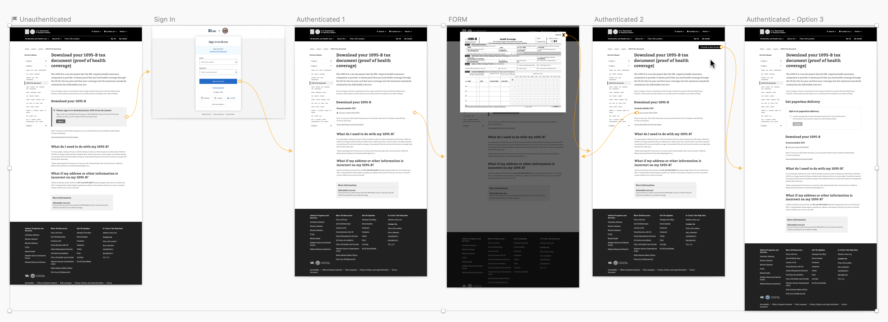
1
DESIGN
Round 1 Research Prototype
The prototype included medium fidelity screens with versions for: unauthenticated , authenticated and paperless opt in versions along with simulated sign-in page and 1095-B PDF
Prototype
02-22 Sprint 2 Demo
Design
11

Slide 12
1
DESIGN
Overall Findings
Design and content was well received, clear and easy to use
The main flow from sign-in to download was well understood, participants found the download CTA quickly
Method to fix errors with the 1095-B PDF was clear
Participants generally saw the FAQ question and associated telephone number regarding incorrect information, before they opened the actual 1095-B form. This was likely due to it being a usability test, and not indicative of real world behavior.
Keeping directions with how to fix information near the download CTA is likely important going forward
Research notes and synthesis
02-22 Sprint 2 Demo
Design
12

Slide 13
1
DESIGN
Research Theme: Recall & Recognition
5/6 participants recalled getting the 1095-B form in the mail from the VA when explained in the context of it being “proof of health insurance” or “health coverage” form.
Many explained that when they got in the mail, they filed it away for safe keeping until it was time for them to file their taxes or send their files to a tax preparer. Some made electronic copies of the paper form for easier access or the ability to use it on their computer during tax preparation.
“Every year with the healthcare law, I get the 1095 [mentioned by name, unprompted] that I provide to my accountant when he does all our taxes…
I just collect all that, then I create a pdf and then I drop an envelop of the hard copies off to the accountant. So that’s where everything gets tucked: the 1095s, W2s, 1099’s, all of it.”
- Participant 8
02-22 Sprint 2 Demo
Design
13

Slide 14
1
DESIGN
Research Theme: Digital vs Physical Delivery
4/6 participants preferred digital delivery. The remaining 2 participants, who were both over 65 years old, were comfortable with digital but preferred paper due to a sense of security and ease
Reasons cited for preferring digital were: ease of use / less hassle than paper, efficiency, ability to organize, and environmental benefits of saving paper
“I don't need the hardcopy mail and I prefer to do things electronically. It's just a lot quicker and efficient. And saves trees and hopefully taxpayer dollars.”
- Participant 3
“I do both [physical and digital] but I probably prefer the physical mail, because then it’s reminding me of these things I might need… [and] I probably am not going to lose it.”
- Participant 7
02-22 Sprint 2 Demo
Design
14

Slide 15
1
DESIGN
Research Theme: Paperless Opt-In Delivery
A second version of the authenticated download screen was shown with an option to sign up for paperless delivery. Version shown was to test concept, not execution.
Participants generally liked the ability to sign up for paperless delivery, with many of the same reasons cited as preferring digital download
We didn't test larger, complex issues connected with paperless delivery: whether setting it at an individual page level vs profile/preferences level, how paperless delivery should be managed across all VA documents or in relation to email, SMS and other notification preferences.
02-22 Sprint 2 Demo
Design
15

Slide 16
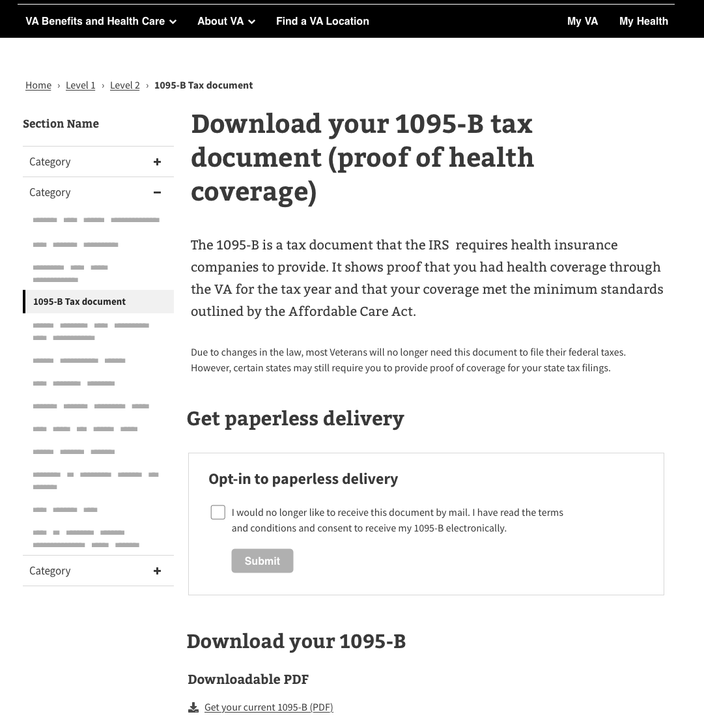
“This looks different. This is great (paperless). Less mail I get, the better. With mail, stuff gets missed or lost, so having e-delivery is great. I love to get that option…
I do all my bills if there’s an option for paperless. I get an email and then go get it”
- Participant 2

Slide 17
1
DESIGN
Research Theme: Nobody wants to make a call
The prototype was tested with the MVP solution – calling a 1-800 number to the enrollment center - for updating information on the 1095-B document if some of the information was wrong.
5/6 participants were negative towards calling a customer service phone number.
Expectation that there would be a long wait if they needed to call to update the form. Digital is seen as an opportunity to avoid the hassle, with an expectation they could update the form via messaging or online tool
2/6 participants said they wouldn’t bother calling the customer service number if their address was wrong on the document. Under real world conditions, outside of usability testing, this is likely to be more common behavior.
02-22 Sprint 2 Demo
Design
17

Slide 18
“I'm not going to get on the phone for an hour and talk to somebody just to change my address... but if I was [going to fix it], I'd be more likely to do it if there was just like an online form… Because, if it takes more than a couple days and you want to file your tax return then [the VA will] have to be pretty fast I think.”
- Participant 3
“Because you're talking about a phone number for a government entity. And some people are gonna place that in the same category is calling Comcast because their internet's out… So maybe maybe an option also to, to email, if it's feasible.
- Participant 8

Slide 19
1
DESIGN
Research Theme: Do I need this?
4/6 Participants were unclear if they actually needed the 1095-B to submit with their taxes.
Participant 3 attended law school and understood the legal requirements clearly.
There seemed to be a general attitude that if the VA sends it to me its of some importance and it was connected to filing taxes.
All participants reported keeping the 1095-B document with their other files, in preparation for filing their taxes themselves or sending it to a tax preparer.
Only one participant lived in a state where it was needed to file with their State taxes. The remaining participants didn’t need it to file.
“In Turbotax, there’s a checkbox that says do you need a 1095-B? I always say I got one. Guessing there’s probably some kind of penalty if I didn’t get one.”
- Participant 2
“This particular form [1095-B], I'm not sure I even need it.”
– Participant 6
“It seems like they probably send me something that says I'm covered for Obamacare, or or something.”
- Participant 7
02-22 Sprint 2 Demo
Design
19

Slide 20
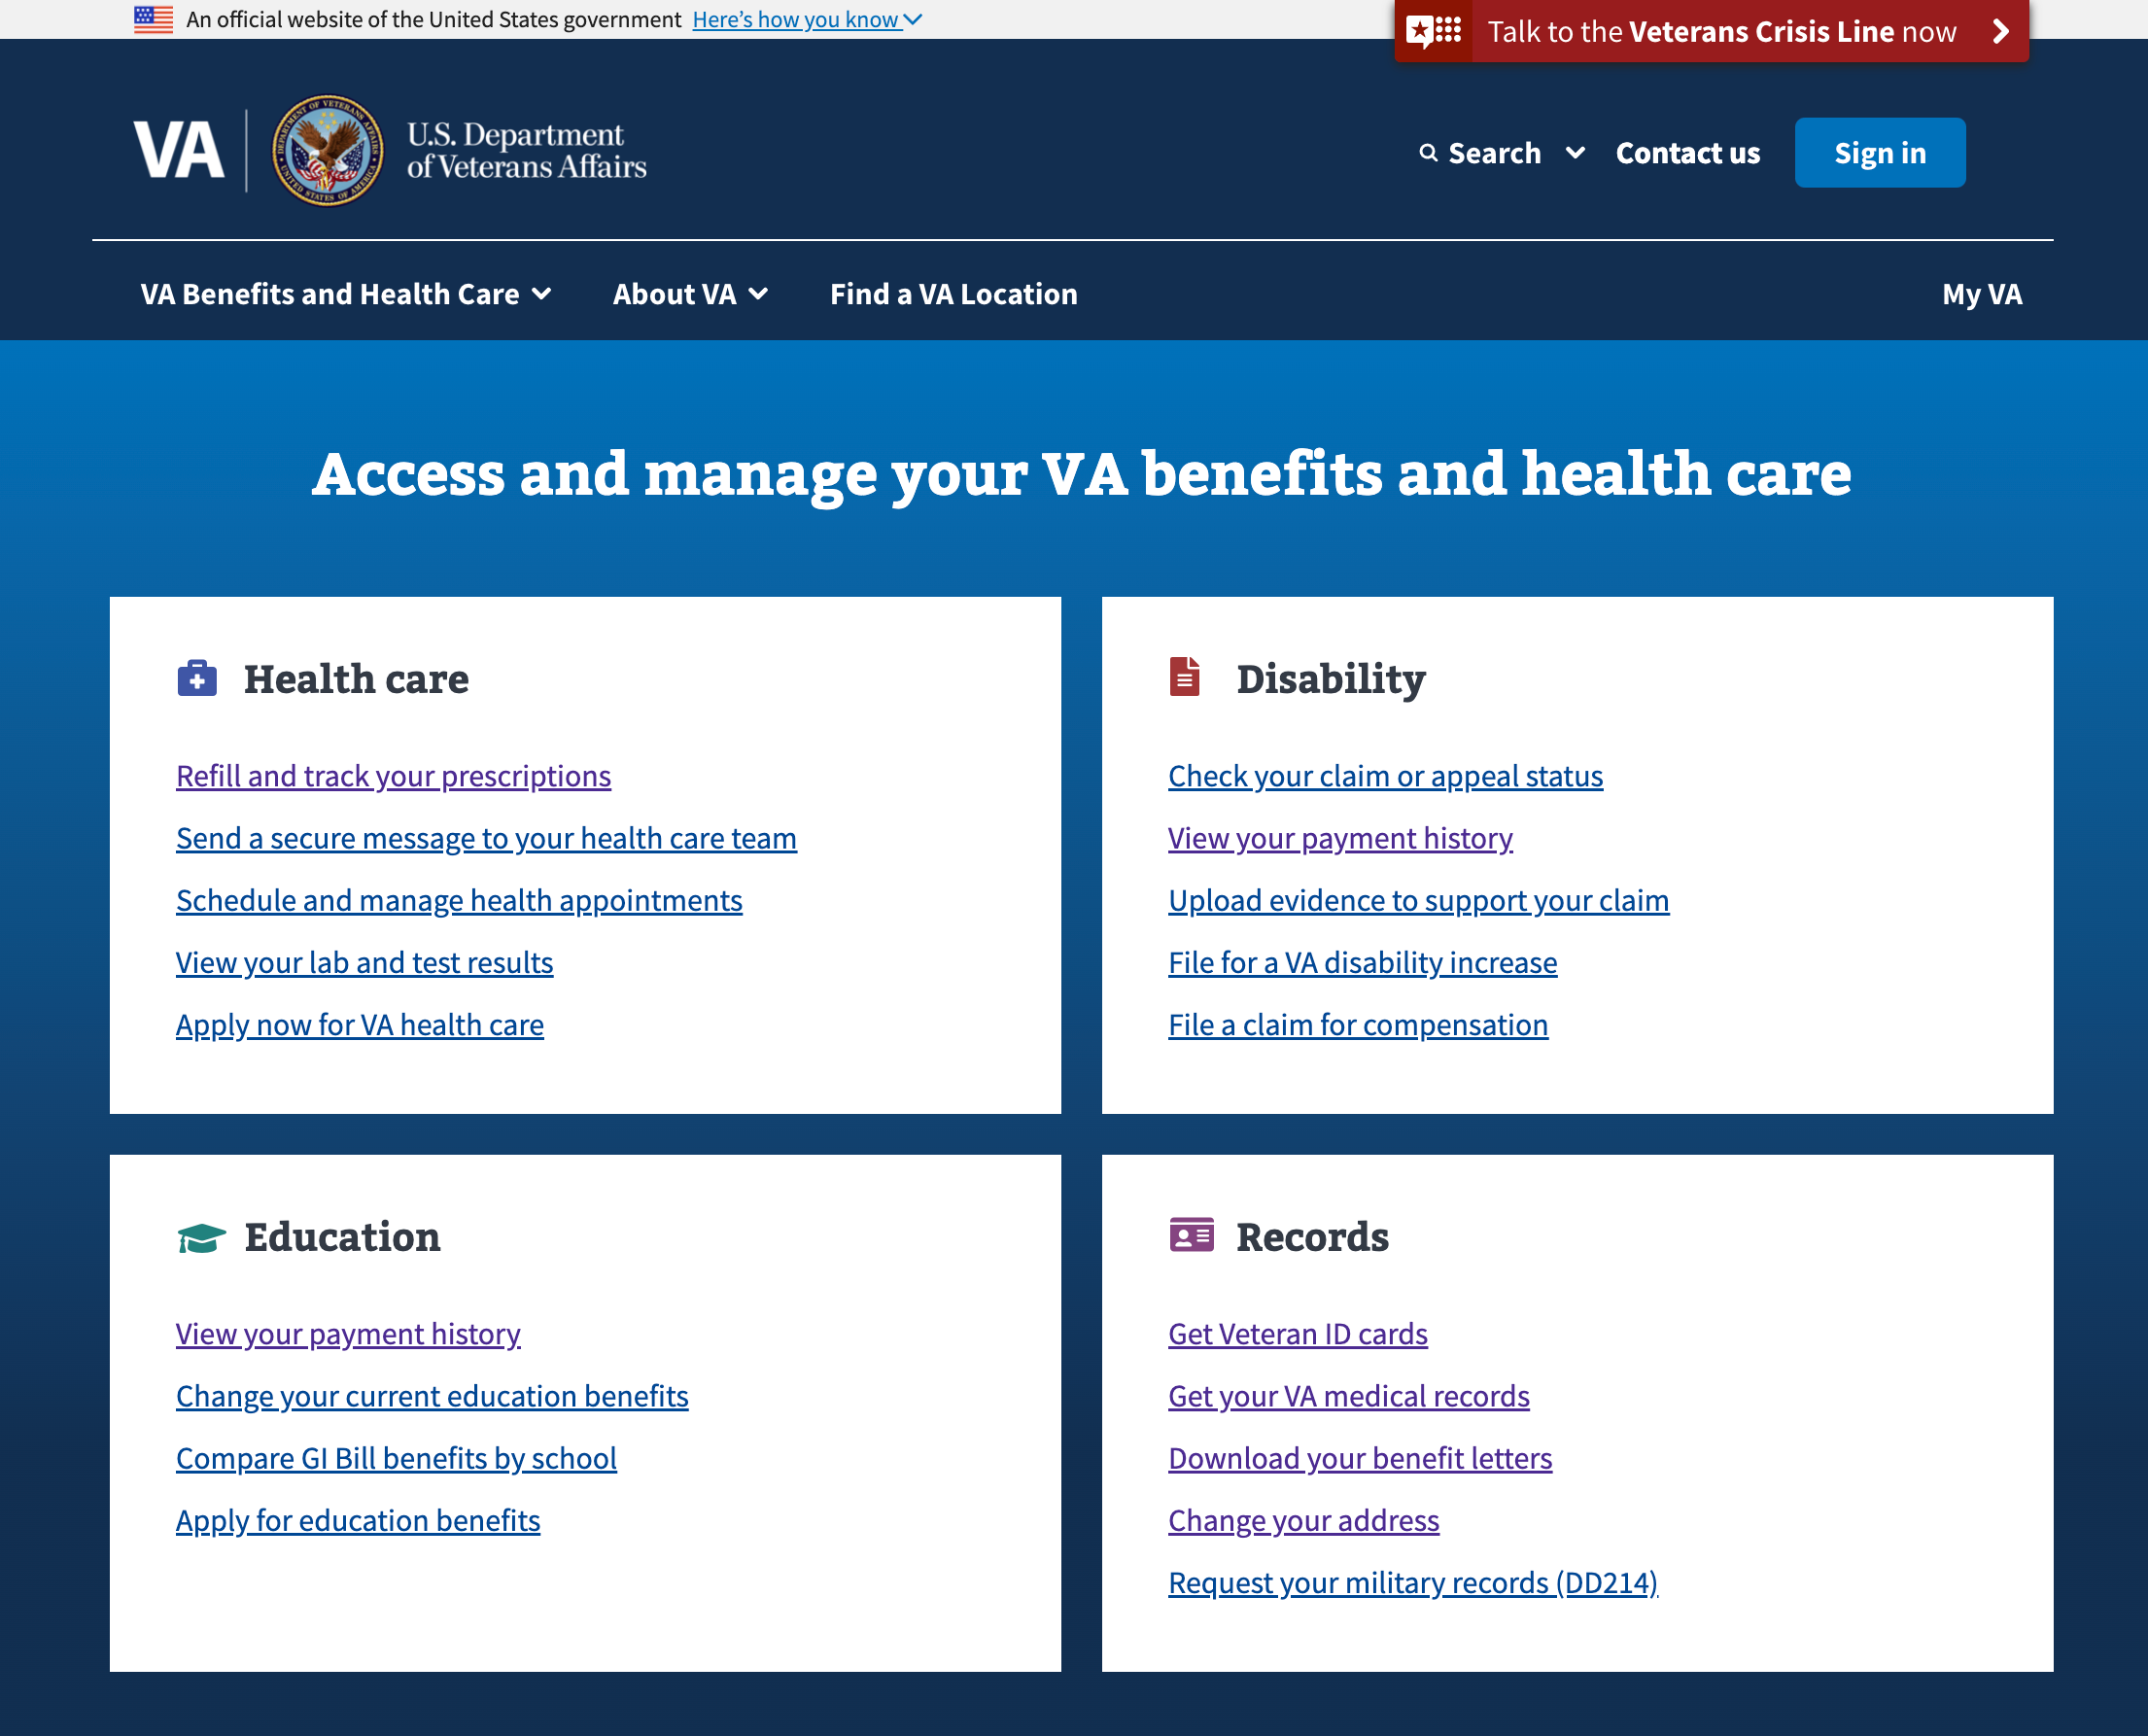
1
DESIGN
Research Finding: Finding the 1095-B Document 1/2
Participants were prompted to visit the VA.gov website and asked where they might look for the 1095-B form.
4/6 Participants went to the Records panel first, with the remaining 2/6 participants going to the Health care panel first.
Asked for additional areas they might look for the document, 2 participants who initially selected Records said they might try Health care.
02-22 Sprint 2 Demo
20

Slide 21
1
DESIGN
Research Finding: Finding the 1095-B Document 2/2
Only one participant said they would try “search” unprompted, and only 2 went to the main navigation in the header unprompted.
There was no clear link under Records where participants might expect to find the 1095-B without the title being changed
It is likely that most traffic to the 1095-B landing page will result from emails directly linking the 1095-B page, as well as Google searches. A top level link on the homepage is not necessary nor recommended.
Our team will discuss and review options with IA team going forward.
02-22 Sprint 2 Demo
21

Slide 22
1
DESIGN
Recommendations & Next Steps
The design for downloading the 1095-B is clear and well understood, with all participants easily completing the task of viewing the document. No major design changes needed.
Reduced some written content to be more direct and less redundant; Clarified content on state requirements and included the affordable care act link in body copy.
Improved visual hierarchy in high fidelity designs
For next round of user testing with high fidelity designs, further explore preferences around updating the form (if information is incorrect) and how the participants understand the requirements of keeping the 1095-B document and including it their taxes.
02-22 Sprint 2 Demo
Design
22

Slide 23
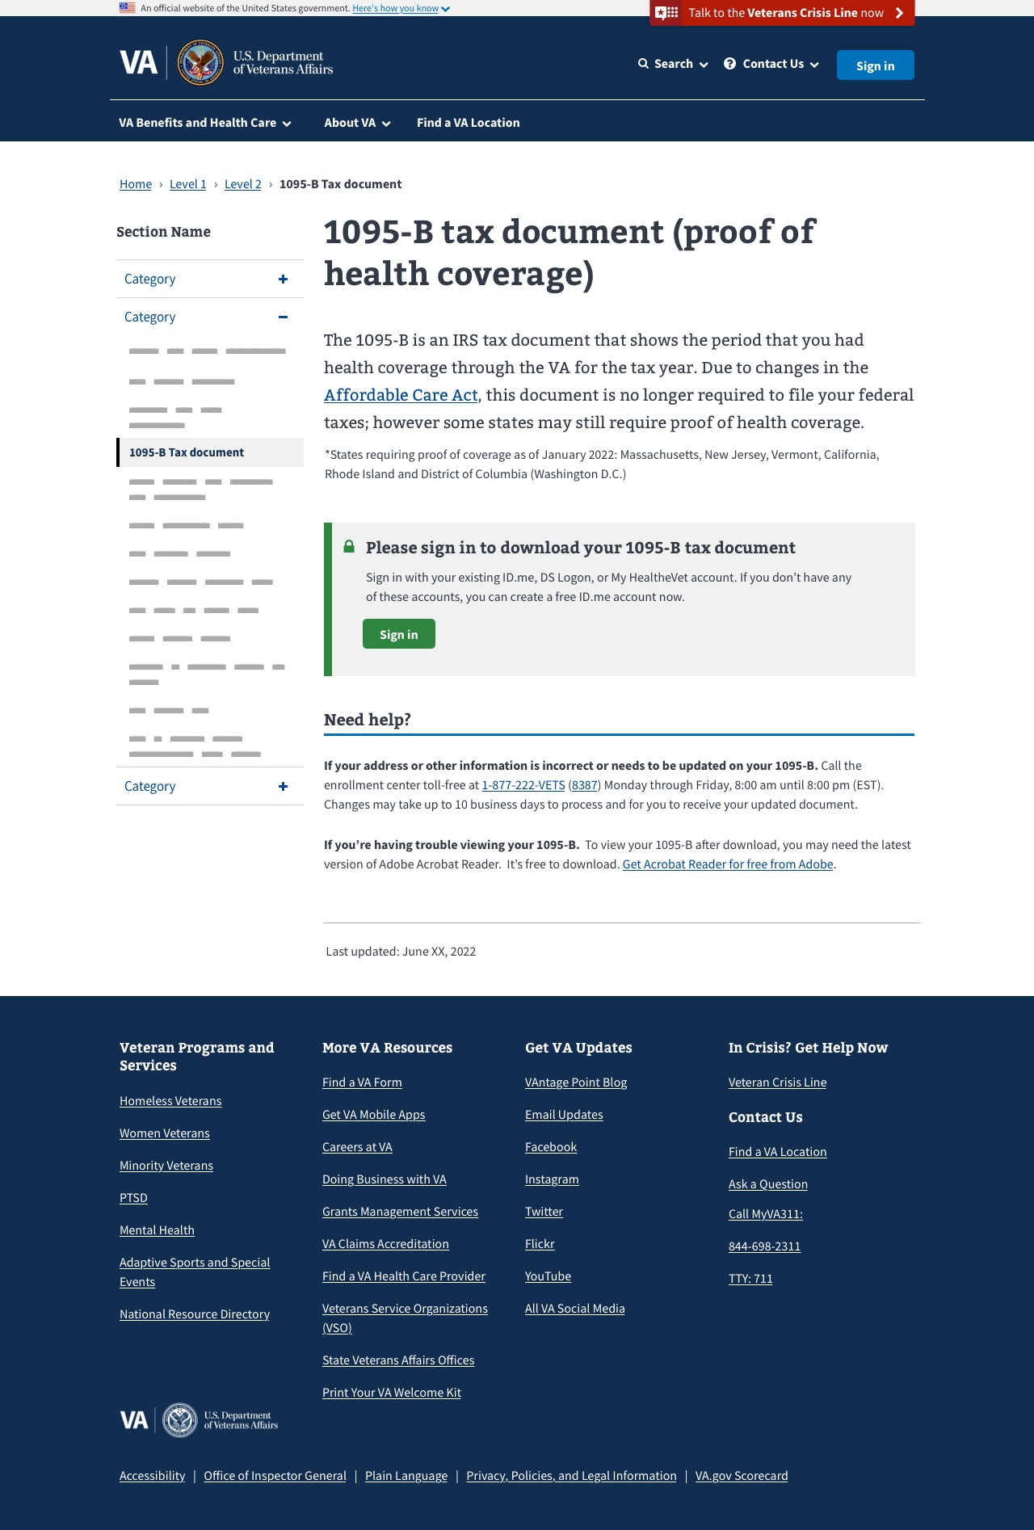
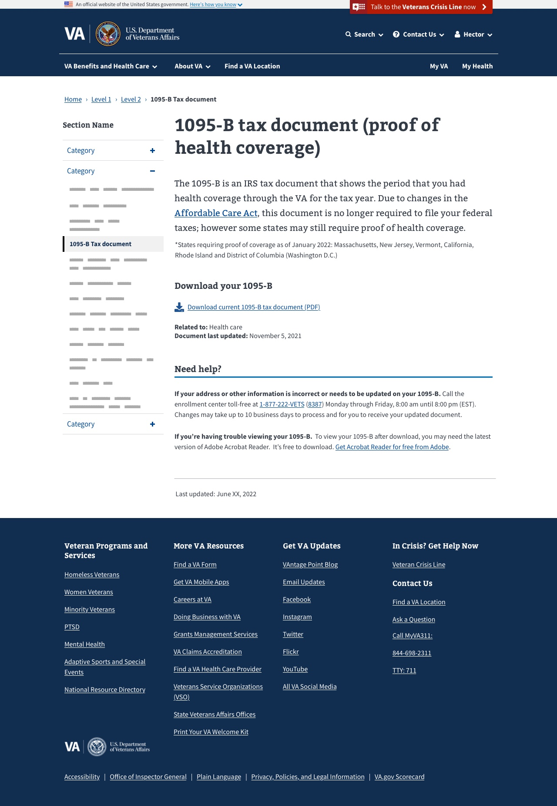
1
DESIGN
Unauthenticated
Authenticated
We updated our designs to high fidelity and incorporated feedback from Veterans and stakeholders
User Story: Update designs to high fidelity
User Story: Iterate designs based on VA-PO feedback
See next page for detailed view
Unauthenticated and authenticated Link
02-22 Sprint 2 Demo
Design
23

Slide 25
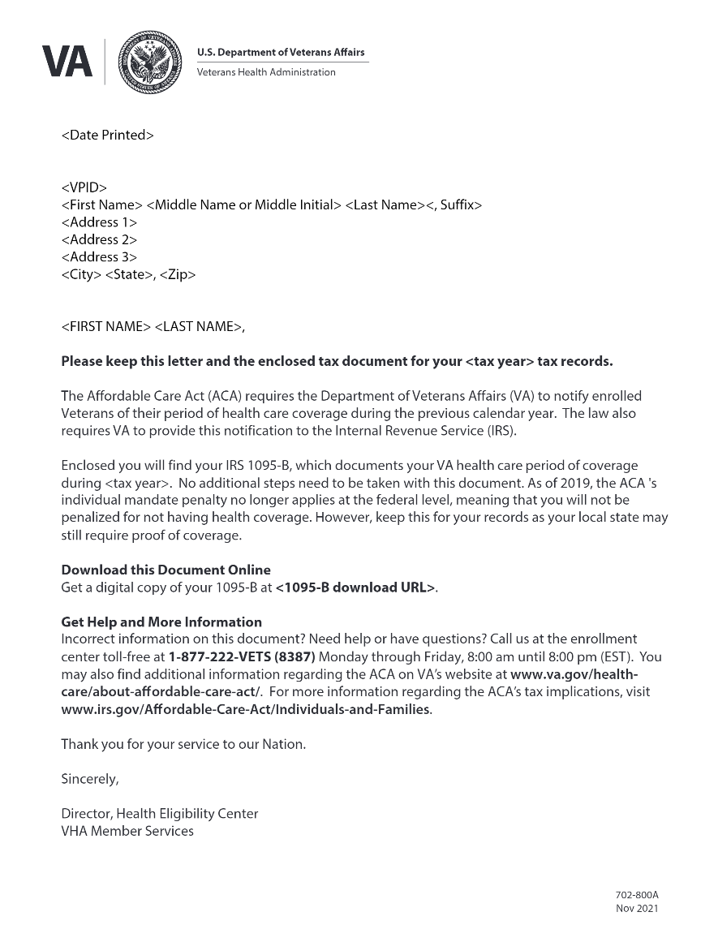
1
DESIGN
We drafted the content the Veteran would see in the product
User Story: Draft cover letter and iterate on content
Streamlined terminology, updating references of "form" to "document"
Highlighted updates in law that impact what this form is needed for / what Veterans need to do with it
Added callout for digital download, with link
Updated "More Information" sub-header to be more actional and inclusive of help. Also, in body called out "enrollment center" to clarify which VA department
02-22 Sprint 2 Demo
Cover Letter Link
Design
25

Slide 26
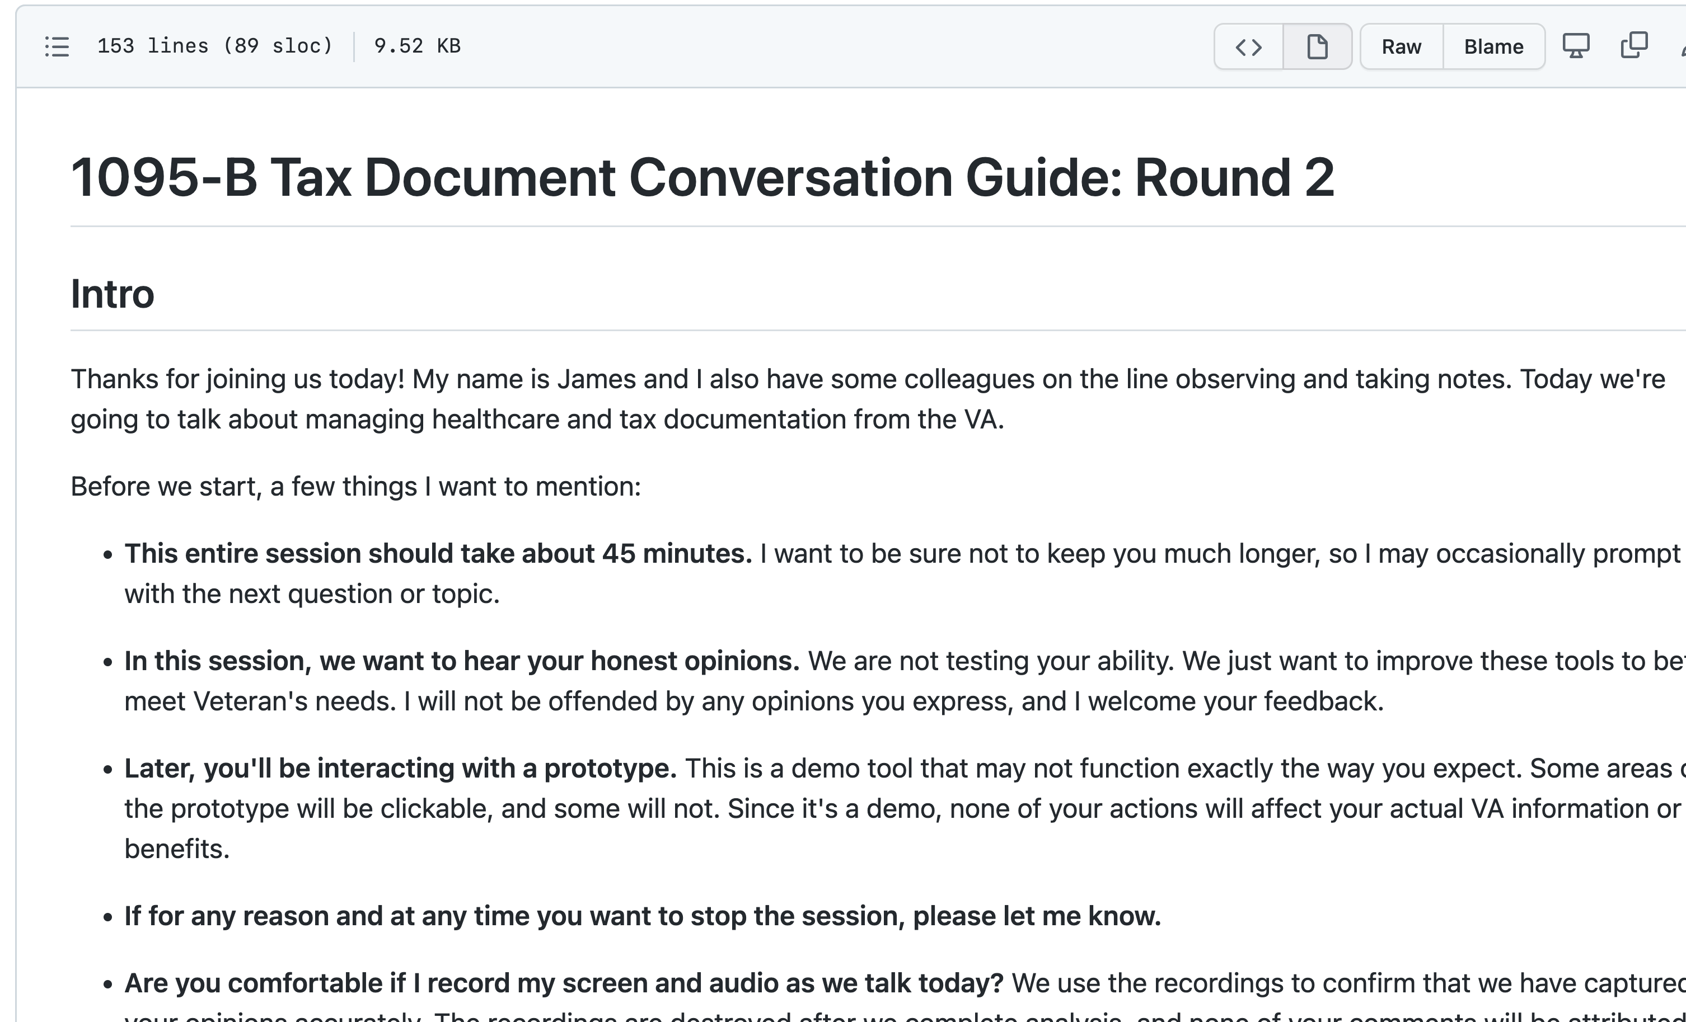
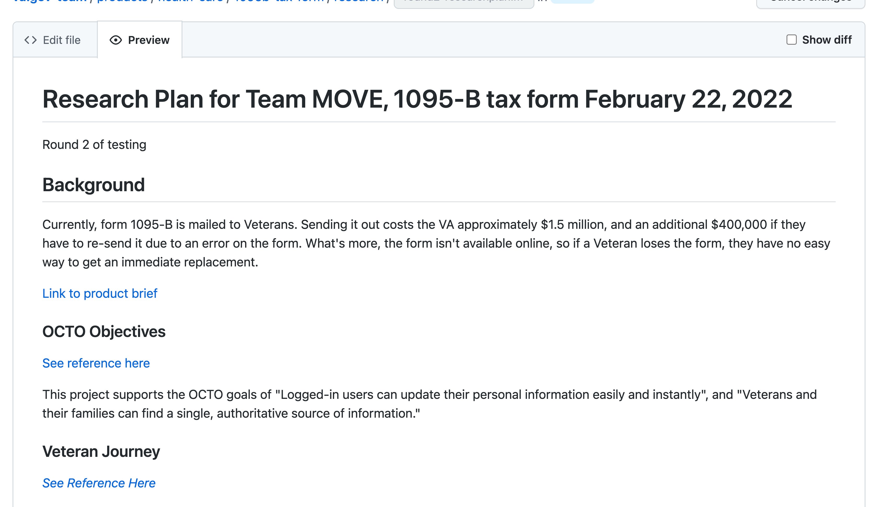
1
DESIGN
We planned for our second round of user testing to gather additional feedback
User Story: Update research plan for second round of usability testing
User Story: Update conversation guide for second round of usability testing
UPDATED RESEARCH OBJECTIVES
Test usability of proposed solution with updated, high fidelity designs
Continue to discover needs, pain points and preferences for physical and digital delivery of the form
Clarify participants understanding of requirements for keeping and using the 1095-B
Research Plan and Conversation Guide
02-22 Sprint 2 Demo
Design
26

Slide 27
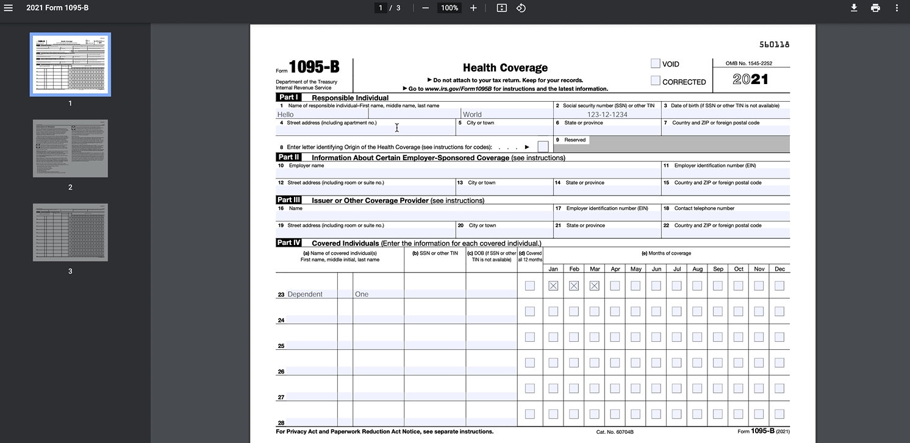
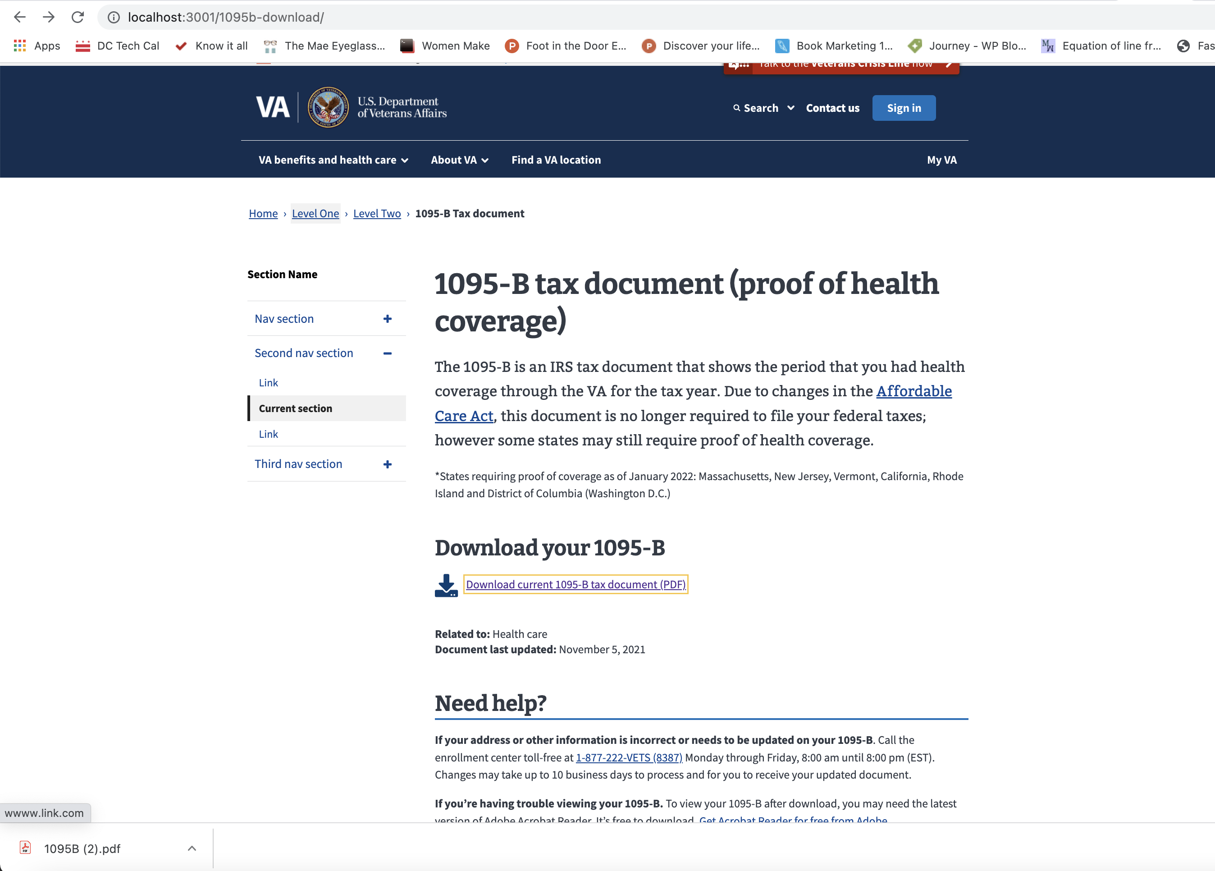
2
TECH
To start to bring the product to life, we built a proof of concept of how to generate a PDF and started our front end build
User Story: Start POC of generating a PDF using sample data
User Story: Start POC of front-end dummy page to be rendered locally
 | Our POC shows how we can pull from a set of sample data and pull it into a PDF
POC of front-end page
POC PDF Generation Video Recording
02-22 Sprint 2 Demo
Tech
27

Slide 28
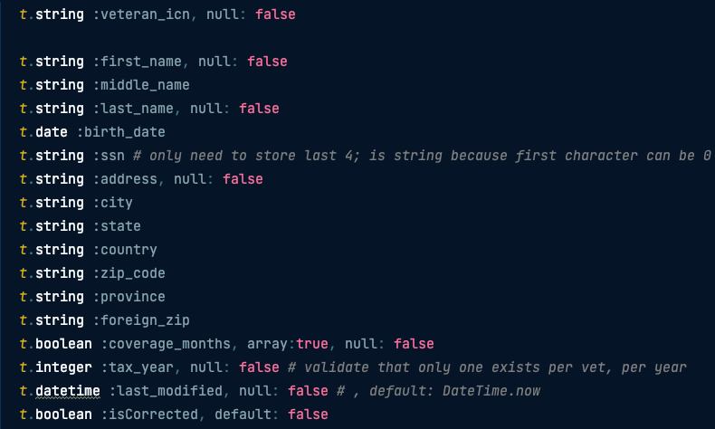
2
TECH
We laid the foundation for our backend and started our Rails model to handle our database
User Story: Understand how to provision S3 bucket and database
User Story: Set up Rails model to map to table and standup database table
Rails Model connects our application to the database where we have the PDF data stored, allowing us to grab the data, and fill out the PDF for the Veteran to download.
AWS request and Rails Code
02-22 Sprint 2 Demo
Tech
28

Slide 29
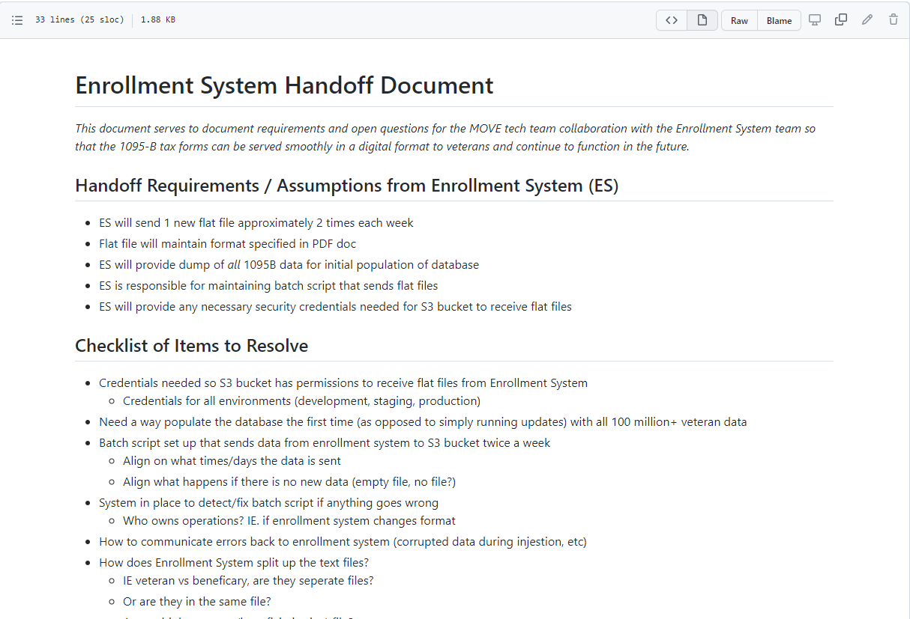
2
TECH
To set up for the next stage, we documented how the existing enrollment system and our product would work together
User Story: Align with Technical POCs on approach and handoffs
Confirmed with Enrollment System POC Joshua Faulkner that:
Enrollment Systems will send 1 new flat file approximately 2 times each week
Flat file will maintain format specified in PDF doc that was sent to us (ACA-MEC_ICD_2.0.pdf)
Enrollment System will provide dump of all 1095-B data for initial population of database
Enrollment System is responsible for maintaining batch script that sends flat files
Enrollment Systems will provide any necessary security credentials needed for S3 bucket to receive flat files.
We are now aligned for the next sprint to begin pulling data from the Enrollment System
Handoff document link
02-22 Sprint 2 Demo
Tech
29

Slide 30
We mapped out our draft of our path to launch in detail
3
PRODUCT
User Story: Create sprint-by-sprint product roadmap for 1095-B
EPICS
SPRINT 2
SPRINT 3
SPRINT 4
SPRINT 5
Find the Form
As a Veteran, I want to quickly navigate to my form once I log in
As a Veteran, I want to use VA.gov search functionality to easily search for my form
As a Veteran, I want to easily find the form through Google so that I can find it through my normal methods
As a Veteran, I want to use VA.gov search functionality to easily search for my form
Access the Form
Start POC of front end dummy page to be rendered locally
POC of PDF generation
Align on handoffs with VA enrollment system team
Understand how to provision S3 and database
Set up Rails model to map to table and stand up database table
Start to set up controller for endpoints currently blocked by S3 provisioning
Provision backend for S3 bucket (or integrate with existing
Write POC for the script to get data from flat file to database
Make POC script production ready e.g., add error handling
Build data mapping to real data
As a Veteran, I want to download my form so that I can have it for my records
As a Veteran, I want to understand what the form is so I know what to do with it
As a Veteran, I want to learn about the form so that I know whether or not to log in to download it
As a Veteran, if I’m not logged in, I want to be redirected back to login to download the form
User Acceptance Testing to validate how to access the 1095-B page – unauthenticated
User Acceptance Testing to validate how to access the 1095-B form – authenticated
Update from feedback from staging review
Final updates from UAT and QA as needed
Get Help
As a Veteran, I want to ask a question or fix a mistake in my form to avoid any issues
Design
Update conversation guide for second round of usability testing
Update research plan for second round of usability testing
Update designs to high fidelity
Iterate designs based on VA-PO feedback
Conduct UX testing and synthesize findings
Draft cover letter and iterate on content
Wireframe updates from VA-PO, Business Owner, Collab Cycle
Run second round of user testing and synthesize
Finalize content for landing page
Iterate on wireframe edits from staging review
QA build
Iterate on content edits
Iterate on designs for post-MVP build (e.g., Opt into paperless)
Collaboration Cycle
Research Plan Review #2
Midpoint Review
Content & IA Review
Contact Center Review
Privacy & Security Review
Staging Review
Analytics Review
MVP Launch
02-22 Sprint 2 Demo
*Preliminary roadmap for planning purposes; subject to change
Product
30

Slide 31
3
PRODUCT
We identified potential options where a Veteran could opt in to paperless, digital delivery
User Story: Document proposed process for how opt-in would work
1. Implemented by VA Profiles team
2. Implemented on the 1095-B landing page
3. Discuss potential changes to policy
Description
1095-B landing page directs Veterans to the Profiles page (e.g., “Opt in to paperless, digital delivery – click here to be taken to your Profile page”)
Box (e.g., checkbox) on VA profile page for Veteran to Opt-in
Ability for Veteran to opt back out (sign up for mail again)
1095-B landing page has a box (e.g., checkbox) for Veteran to Opt-in with messaging (e.g., “Opt into paperless, digital delivery. By selecting this box and clicking Submit, you are consenting to no longer receive a mailed form and receive digital copies only.”
Ability for Veteran to opt back out (sign up for mail again)
Explore potential policy change so it is no longer required for the VA to send a physical 1095-B and can provide a digital copy to all Veterans, if they didn’t opt in themselves
Example option: all Veterans will no longer receive the mailing, unless they live in a state that requires to be mailed or they request it or could send 1 final round of mailing and notify that this is the last time it will be mailed unless the Veteran 'opts out' of digital delivery
Potential Benefits
All opt-in housed in one central location
While it may take more time to build, it's more likely to be a holistic. "enterprise-wide" solution
Could be designed to be surfaced on same page where the Veteran downloads, so it's top of mind
Matt Self has built an opt out of paperless process for another flow as precedent
More within the control of our immediate team, as we could add it to our backlog to research, design and build, which allows us to drive the timeline more easily
Does not require any work from the part of the Veteran to stop getting the mailed form
Further builds momentum for paperless options at the VA
Some precedent exists, as Matt Self was able to change policy for debt notifications
Considerations
Current capability does not exist; seems to be a net new build
Unclear when this would get built
It's not a place where all opt-in is stored and is built only for 1095-B, it becomes a buried option for the Veteran
Address from the enrolment system might not be the same as the one on Profiles and would need to be reconciled
Starts touching on bigger question of how we connect enrolment system with Profiles
Unclear what the design would be yet (e.g., due to technical constraints, Matt Self had to build a full form in lieu of a checkbox). Would need Tech & Design to investigate further
Based on Matt Self's opt out build, may be difficult and have complications on the backend
Could take a long time to accomplish
Not within our team's immediate control
Open Questions
What is Profile's roadmap? When would Profile be able to build an opt in to paperless?
Could the ‘opt-in’ be stored in the enrolment system? Would it need another system to capture it?
Next Steps: Filled out form to get in touch with Profiles team, awaiting POC from form
Could the ‘opt-in’ be stored in the enrolment system? Would it need another system to capture it?
Next step: Investigate with enrolment system POCs on if they could capture the opt-in field and timeline to do so
How viable would this option be? Would the business have any interest in pursuing a policy change? Is the effort to change the policy worth the time, given the limited scope of the 1095-B document?
Mural Board Link
02-22 Sprint 2 Demo
Product
31

Slide 32
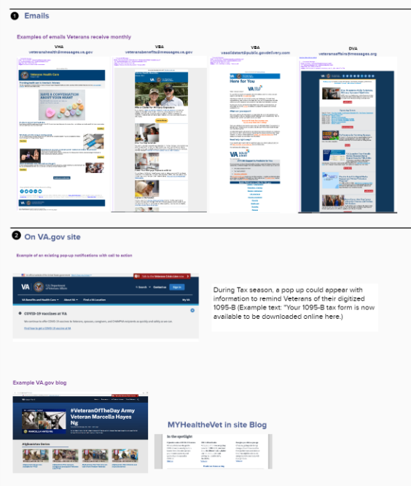
In order to notify Veterans once the form and opt in are launched, we ideated on possible ways to reach Veterans
3
PRODUCT
User Story: Begin to identify rollout plan needs
Example of potential channels to reach Veterans and inform them once the digitized form is launched and/or they are able to opt into paperless, digital delivery:
Emails – VHA, VBA, DVA
VA.gov – top-bar notification, cross-links, posts on VA.gov blog
Social media platforms – VA-owned (Twitter, Facebook, etc.) and non-VA owned (Veteran 2 Veteran info, etc.)
VA.gov help line – e.g., insert a prompt about Form 1095-B into the hold message
Rollout Plan Link
02-22 Sprint 2 Demo
Product
32

Slide 33
Sprint 2 Deliverables
EPIC | STORY | ESTIMATE | ASSIGNED | OUTPUT | REVIEWED WITH VA-PO | SPRINT TEAM GOAL COMPLETED?
Design | #36139 Conduct UX testing and synthesize | 13 | James | Research Report in GitHub Notes Excel Design Review Deck | 2/17/22 | ✓
Design | #36181 Update designs to high fidelity | 8 | Grace | Unauthenticated wireframe Authenticated wireframe | 2/17/22 | ✓
Design | #36143 Iterate designs based on VA-PO feedback | 3 | Grace | Unauthenticated wireframe Authenticated wireframe | 2/17/22 | ✓
Design | #36711 Draft cover letter and iterate on content | 5 | Carl | Cover letter | 2/17/22 | ✓
Design | #36171 Update conversation guide for second round of usability testing | 2 | James | Conversation guide #2 | 2/22/22 | ✓
Design | #36166 Update research plan for second round of usability testing | 1 | James | Research plan #2 | 2/22/22 | ✓
Tech | #36479 Start POC of generating a PDF using sample data | 8 | Nadya | Recording in Mural | 2/17/22 | ✓
Tech | #37013 Start POC of front-end dummy page to be rendered locally | 5 | Nadya | Github Branch | 2/22/22 | ✓
Tech | #36506 Understand how to provision S3 bucket and database | 3 | Teagan | AWS Access ticket (Teagan) S3 bucket request | 2/17/22, 2/22/22 | ✓
Tech | #37011 Setup Rails model to map to table and standup database table | 8 | Teagan | GitHub branch | 2/22/22 | ✓
Tech | #36478 Align with technical POCs on approach and handoffs | 3 | Nadya | Handoff document | 2/17/22 | ✓
Product | #36481 Create sprint-by-sprint product roadmap for 1095-B | 5 | Ashley | Tickets in Zenhub Slide 30 as overview of plan | 2/17/22 | ✓
Product | #36542 Document proposed process for how opt-in would work | 8 | Jordan | Opt In Options Mural Slide 31 as synthesis | 2/17/22 | ✓
Product | #36480 Begin to identify rollout plan needs | 5 | Jordan | Post MVP Communication Mural | 2/17/22 | ✓
02-22 Sprint 2 Demo
Sprint 2 Deliverables

Slide 34
Preview of Sprint 3
SPRINT 2 DEMO

Slide 35
Sprint 3 will run February 23rd to March 8
Owned by design team
Owned by product/ engineering team
Release
SPRINT 0
SPRINT 1
SPRINT 2
SPRINT 3
SPRINT 4
SPRINT 5
Week 1: 01/20 – 01/26
Week 2: 01/26–02/02
Week 3: 02/02 – 02/09
Week 4: 02/09 – 02/16
Week 5: 02/16 – 02/23
Week 6: 02/23 – 03/02
Week 7: 03/02- 03/09
Week 8: 03/09 – 03/16
Week 9: 03/16 – 03/23
Week 10: 03/23 – 03/30
Product & Delivery
Build backlog
Identify Change Management or Communications Plan
Handover plan - Prepare for launch
PIV Onboarding
Prioritized backlog
Immersion & onboarding
User Experience & Design
Immersion & onboarding
Testing prep
Testing prep & recruiting
Create post-MVP design refinements
Voice of Veteran
Voice of Veteran
PIV Onboarding
Wireframes & Design
Design iterations
Design iterations
Design QA
User flows
Engineering & Development
Create tech discovery plan
Data discovery
POC for data flow
Immersion & onboarding
Define data flows - Systems mapping
Build solution (form UI, data connections, storage, etc.)
UAT
Test & Refine
Collaboration Cycle
Kickoff
Analytics Review
Analytics Review
Contact Center Review
Research Plan Review
Design Intent
Research Plan Review #2 (wireframes)
Content & IA Review
Midpoint Review
Privacy & Security review
Staging Review
MVP Launch
*Does not show post MVP Validate phase meetings in Collaboration Cycle, such as Full Accessibility Audit and Post-Launch Check In
02-22 Sprint 2 Demo
Preview

Slide 36
Sprint 3 will focus on building out the PDF generation using real data on staging and conducting a second round of testing
1
PRODUCT
Start the product guide and product video for the Contact Center review
Create product video for Contract Center review
Identify if generated PDF is 508 compliant
Prepare for upcoming Collaboration Cycle milestones
2
DESIGN
Run second round of user testing and synthesize findings
Update prototype for second round of testing
Finalize content for landing page
Iterate designs based on feedback from VA-PO and research feedback
Iterate designs based on Business Owner feedback
Iterate designs based on Collaboration Cycle midpoint review feedback
*Stories subject to change during Sprint planning
3
TECH
Write POC for the script to get data from flat file to database
Make POC script production ready
Build data mapping to real data
Start to set up controller for endpoints
As a Veteran, I want to easily understand what this form is so I know why I need it
Provision backend for s3 bucket (or integrate with existing)
As a Veteran, I want to quickly navigate to my form once I log in
As a Veteran, if I'm not logged in, I want to be redirected to log in to be able to download the form
As a Veteran, I want to download my form so that my tax records are complete
As a Veteran, I want to ask a question or fix a mistake in my form to avoid any issues
 | Next sprint demo: March 8
02-22 Sprint 2 Demo
Preview

Slide 37
Appendix
SPRINT 2 DEMO

Slide 38
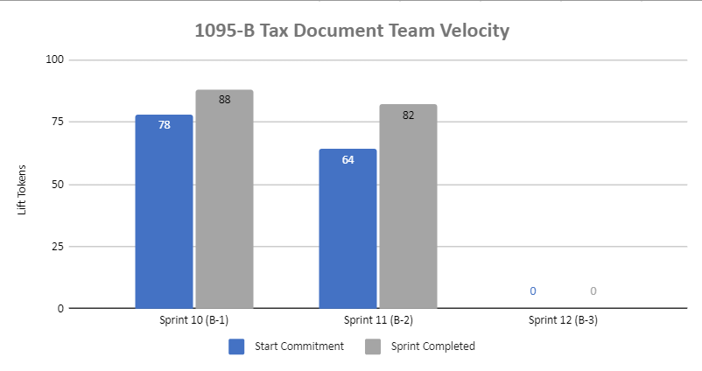
1095-B Sprint team velocity
 | Velocity details Velocity estimated in story points, using Fibonacci All 64 story points committed at beginning of the sprint completed and team exceeded commitment in this sprint Total completed for the sprint: 82 story points Sprint 2 deliverables accounted for 77 points 5 points were for platform orientation for new team member Added 13 points after sprint start as: 8 points added for new team member with their capacity 5 points added for additional capacity for other team members after new team member joined because we could now shift and spread the load Velocity in Sprint 2 accounted for 9 team members (one of whom is new to the team and joined two days after sprint start)
02-22 Sprint 2 Demo
Appendix
38

Slide 39
Project risks and mitigation strategies
Submitted as part of the Monthly Report on February 7th
RISK AND IMPACT | MITIGATION STRATEGY | DATE |  | STATUS | NOTES
 |  | ENTERED | CLOSED
IRS stakeholder is outside of VA ecosystem. Building without guidance or legal review regarding compliance with IRS regulation could result in risk. | Conduct research on available information surrounding current IRS 1095-B tax form regulations. Seek legal review through VA resources as directed by VA-PO and Business Owner | 1/20/22 | 2/11/22 |  | VA Business Owner clarified that IRS review is not needed
02-22 Sprint 2 Demo
Appendix
39

